Slide 1
Advances in Understanding Stormtime Magnetotail Dynamics
Wednesday 11 December 2024
S. Raptis¹, V. Merkin¹, A. Sciola¹, S. Ohtani¹, K. Sorathia¹, J. Tibbetts¹, A. Keesee¹, M. Gkioulidou¹
¹JHU/APL
²University of New Hampshire
savvas.raptis@jhuapl.edu https://savvasraptis.github.io

Slide 2
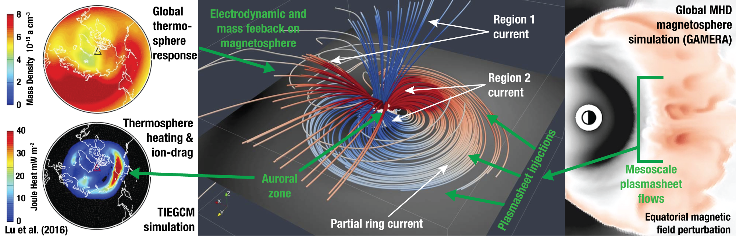
CGS Science Theme 1
Multiscale plasma sheet transport, ring current build-up, and their global impacts throughout stormtime geospace
Today we’ll highlight
- 3 published works (2 in 2023 and one last summer)
- 1 ongoing effort
Notes:
Intention of slide: 1 theme is global scale consequences of mesoscale processes, these scales processes conspire to do large effect
This image here, explains one of these feedback loops, start from thew right, we know that we have these flows that we call bbfs. We know from simulations that build up ring current based on simulation work and observational work.
If indeed, these contribute, through the ring current have (move to second image in the middle). It’s the major current system it contributes to the global reconfiguration of the magnetosphere. It controls (we move to the left) where, when and how much energy is deposited in the thermosphere system which then has feedback in the magnetosphere.

Slide 3
CGS Science Theme 1
Multiscale plasma sheet transport, ring current build-up, and their global impacts throughout stormtime geospace
Today we’ll highlight
- 3 published works (2 in 2023 and one last summer)
- 1 ongoing effort
Plasmasheet/Magnetotail

Slide 4
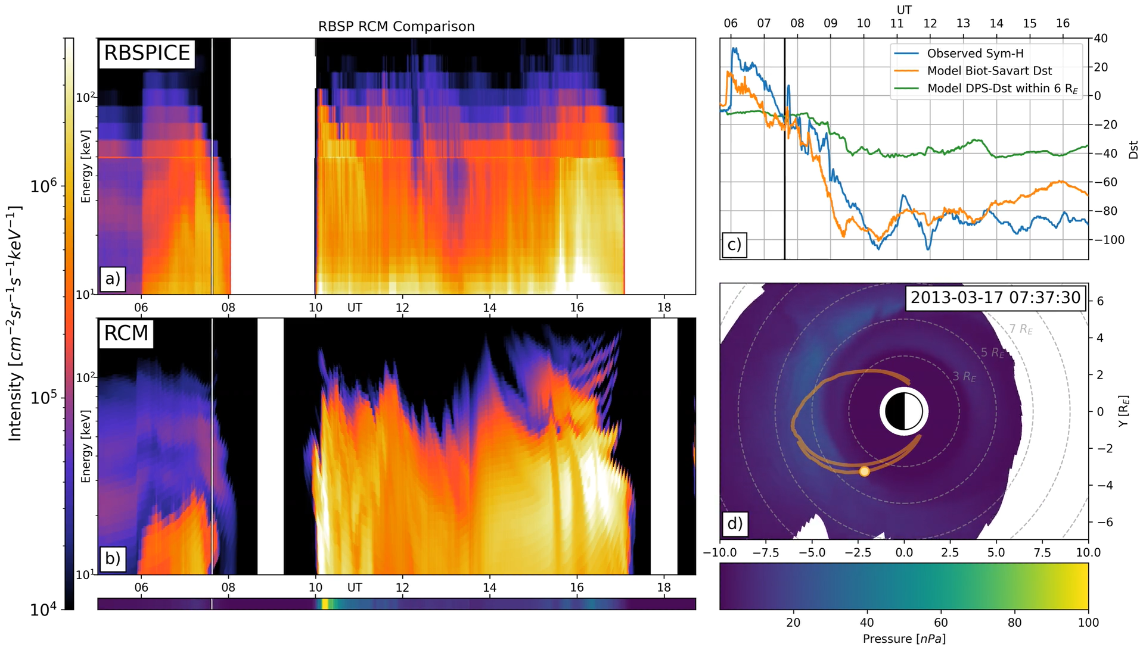
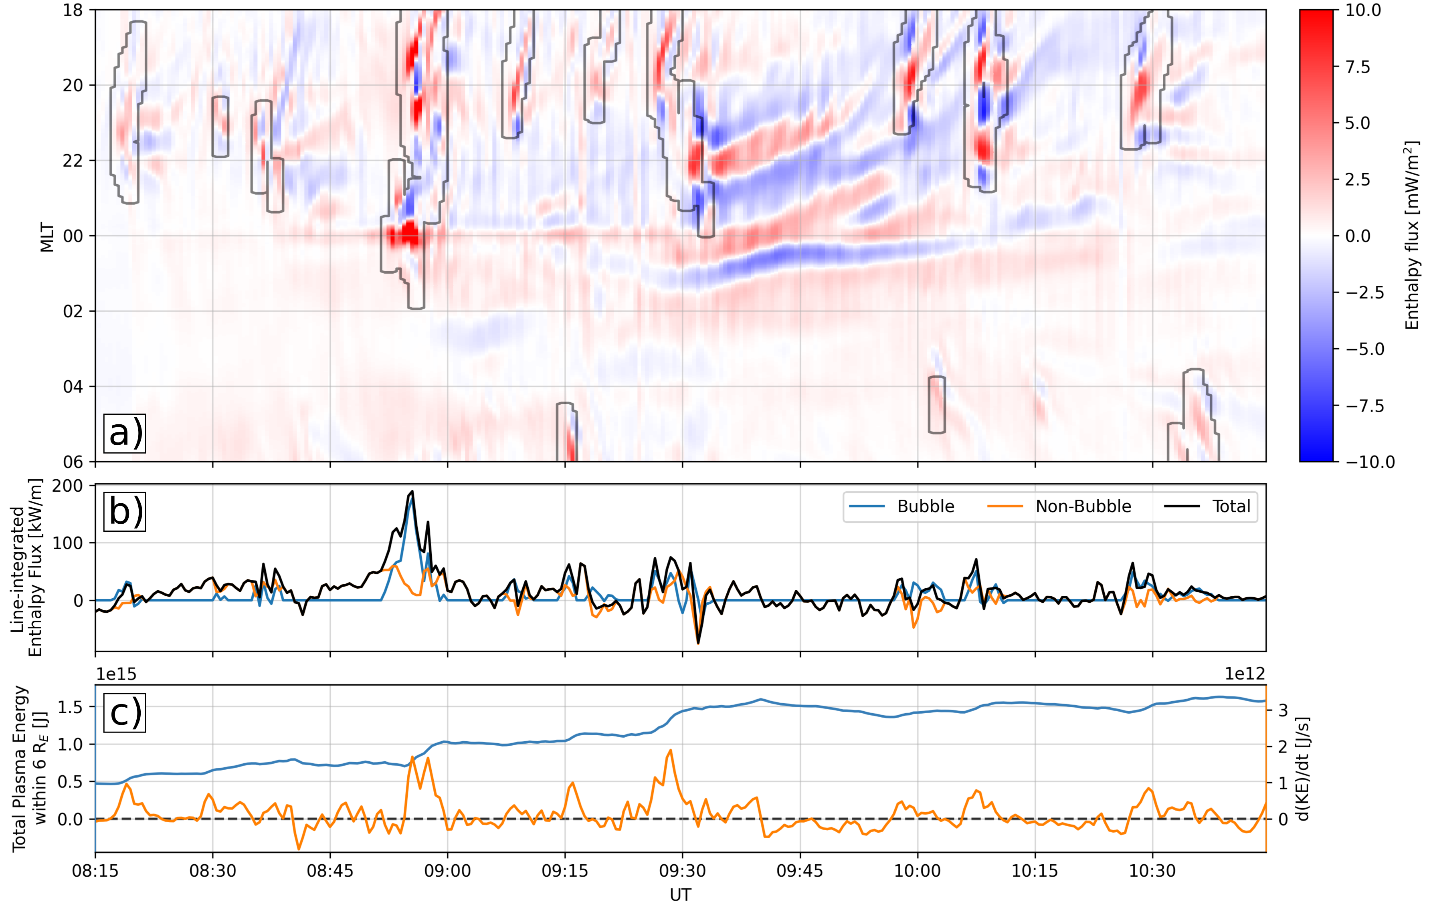

Contribution of plasma sheet bubbles to stormtime ring current buildup
Case study of the March 17, 2013 storm
During initial buildup of the ring current at least 50% of the net transport below 6 R_{E} is due to plasma sheet bubbles
The return flows that accompany bubbles as a result of interchange transport outwards an average of 40% of the plasma energy
The evolution of the modeled ring current energy spectra is due to both an evolving source population and energy-dependent losses
Plasma energy transport through nightside 6 R_{E} arc
MLT
Arc-integrated transport
Full paper
Sciola+ 2023
Notes:
Energy spectra of ring current is changing due to both transport of gradually hotter plasma sheet and energy-dependent losses

Slide 5
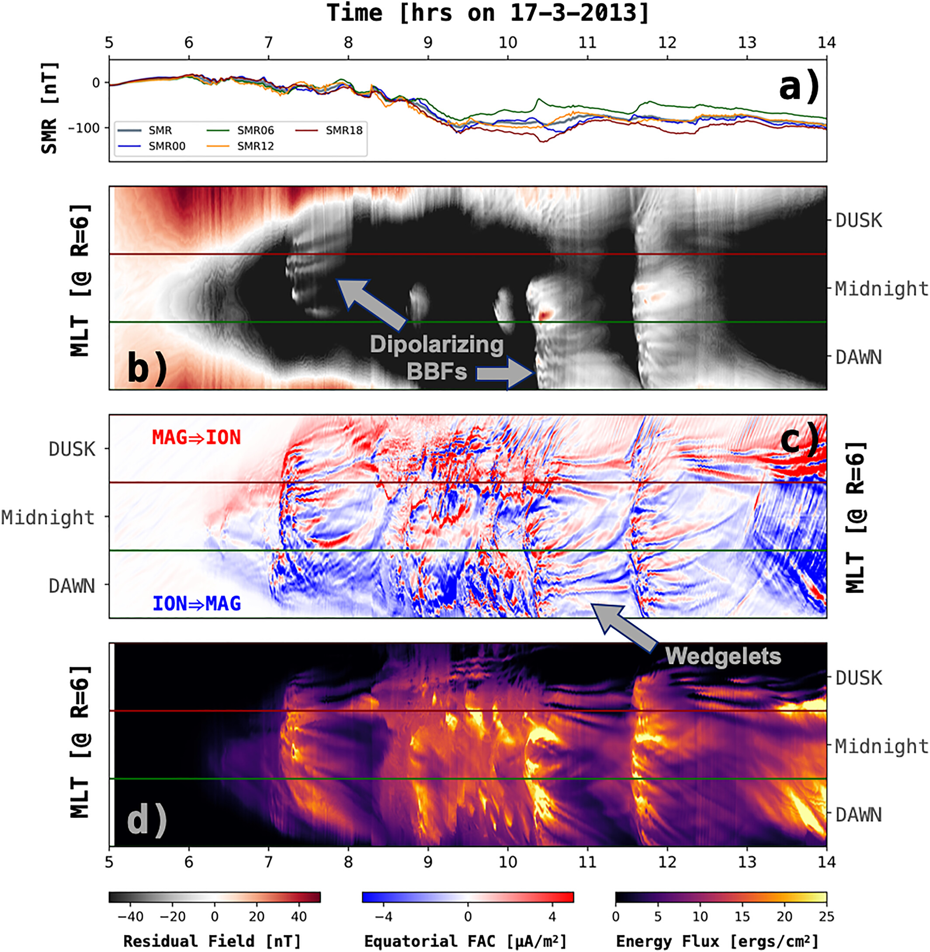
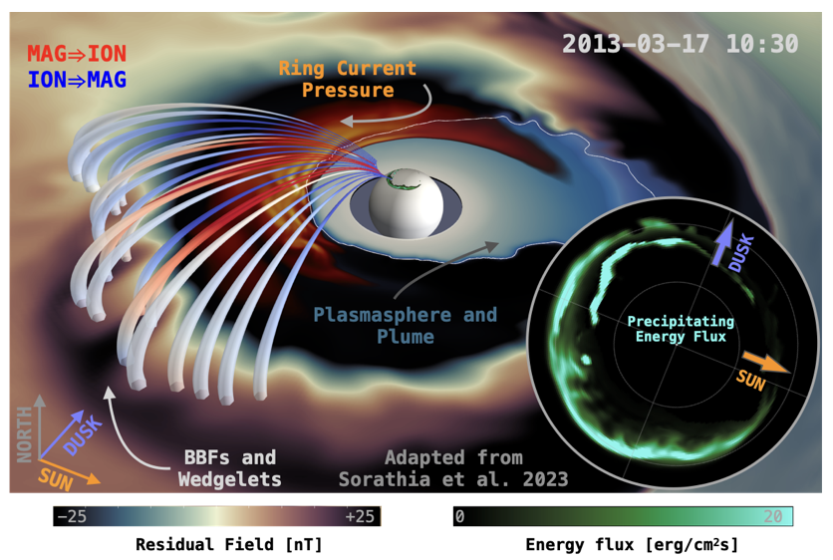

Modeling GMDs w/ MAGE
Stormtime MI Coupling
Dawnside current wedge
Ohtani ’21 and ’23, Sorathia+ ’23
Modeling shows dawnside BBFs during stormtime create multiscale enhancement of the dawnside AEJ
BBFs connect to omega bands & large dB/dt
Dawnside GMDs
dB/dt skewed towards dawn (Schillings+ ’22)
Full paper
Notes:
Beyond Anthony’s work that looked at the contribution of bubbles. However, in parallel, Shin Ohtani has worked on ground based magnetometer data and noticed that during storms we have the DCW system.
Kareem using simulation showed that this DCW is created by the storm-time dusk-biased ring current asymmetrically inflating the tail and skewing reconnection and subsequent BBFs dawnward
As the dipolarization at dawn cause disruption (see bottom plot) we have effects in the whole system, creating omega bands, and localized disturbances (dB/dt) that have space weather implications

Slide 6
Data Analysis Results
Notes:
Roughly 5 minutes

Slide 7

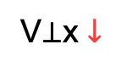
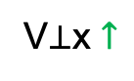
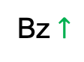
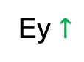
Stormtime Global Convection - Geotail (1994 – 2022)
Full paper
(1)
V⊥x $↓$
(1)
Bz $↑$
Ey $↑$
Dusk
Dawn
(2)
(2)
Outer
Ey
Inner
V⊥x
Bz
V⊥x $↑$
Raptis+ 2024 | GRL

Slide 8
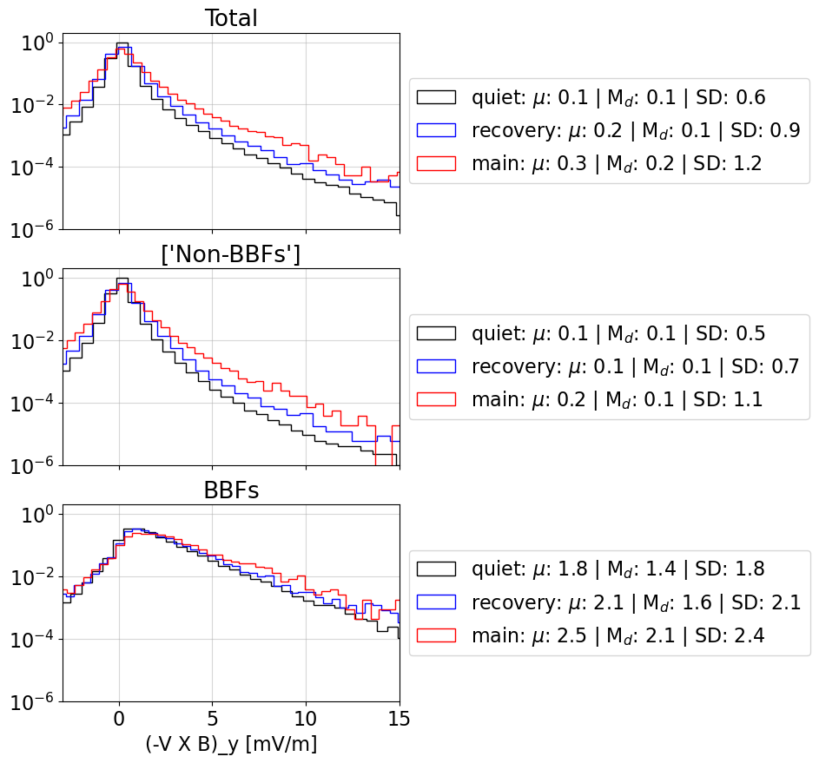
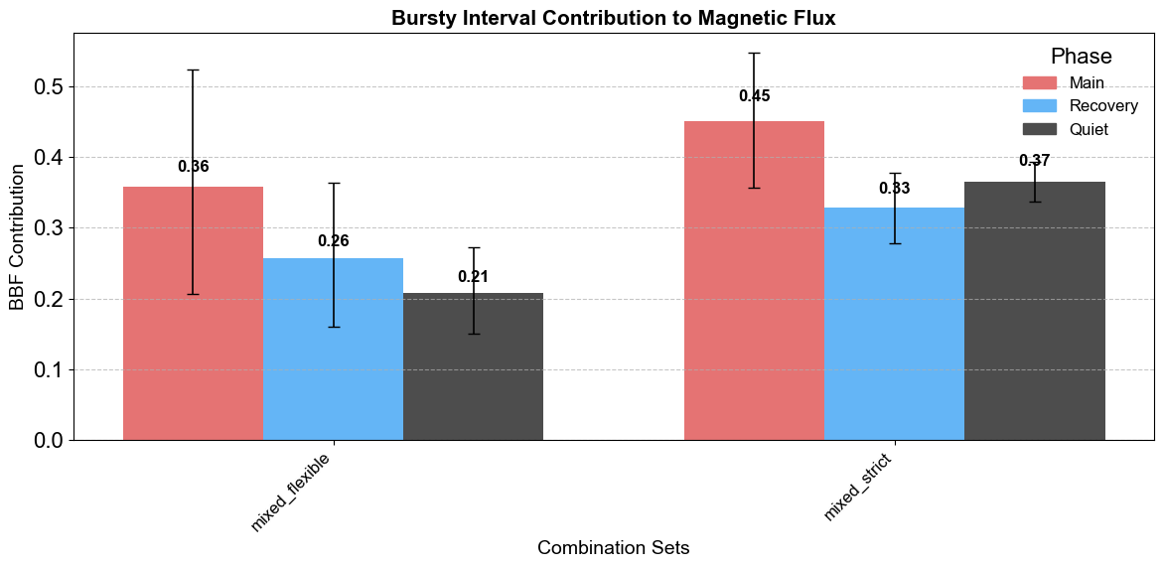
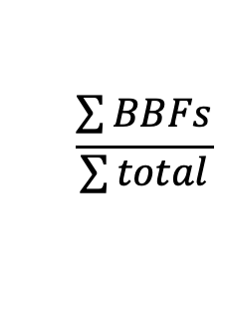
Bursty Magnetic Flux Contribution
Ongoing work
Histograms are normalized per phase
BBFs: 1 point : $v_{⊥,x}>250\frac{km}{s}$ | Interval: $v_{⊥,x}>100\frac{km}{s}$
Error bars: min/max of dataset variations
Flexible
Strict
$$\frac{\sum{BBFs}}{\sum{total}}$$
Similar profiles between phases*
Strict and flexible = Different plasma sheet classification

Slide 9
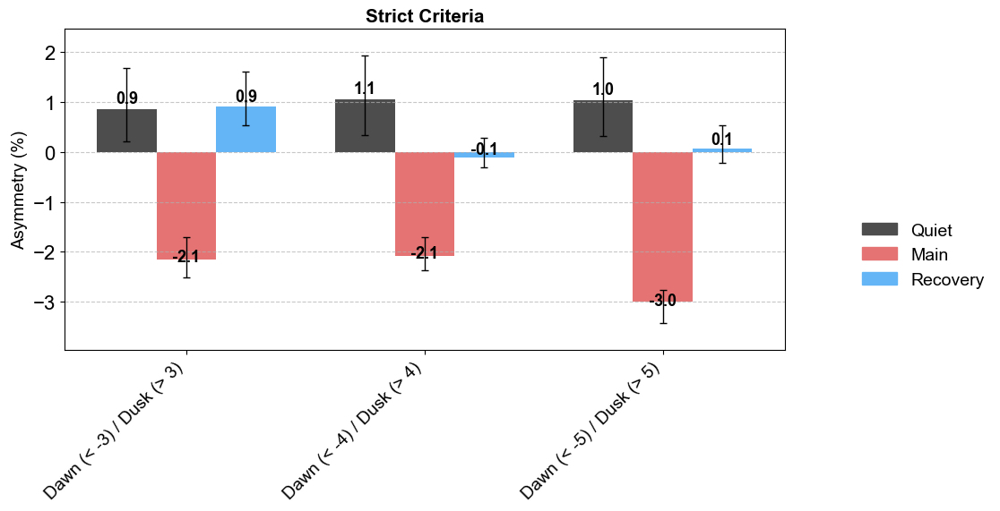
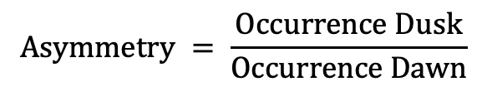
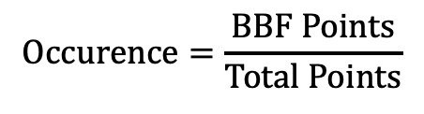
Dawn – Dusk Asymmetry of BBFs/BEIs
Bursty Interval Occurrence: ~2-4% quiet times | ~4-8% main phase
$$Occurence=\frac{BBF Points}{Total Points}$$
$$Asymmetry = \frac{Occurrence Dusk}{Occurrence Dawn}$$
DAWN (<-3 Re)
DUSK (>3 Re)
DAWN (<-4 Re)
DUSK (>4 Re)
DAWN (<-5 Re)
DUSK (>5 Re)
Same message Across all combinations = Dawn preference during main phase and Dusk during quiet
Error bars = min/max based on definition of bursty interval
Different sets = Different definition of dawn/dusk
Consistent with Nagai+ 2023
Reconnection moving Dawnward

Slide 10
Summary
Contribution of Mesoscale Burst Intervals in tail dynamics remains a major unanswered question*
However, recent simulation and observation efforts have showed us that :
During the initial buildup of the ring current at least 50% of the net transport below 6 R_{E} is due to plasma sheet bubbles (Sciola+ 2023).
During storms dawnside BBFs create multiscale enhancement of the dawnside AEJ and cause large dB/dt (Kareem+2023).
Stormtime convection is associated to more dipolar field at dusk and faster flow at dawn (Raptis+2024).
BBFs contribution to magnetic flux transport is elevated during storms, accounting for 30-50% (Ongoing).
BBFs are more frequent during storms, and are more frequent at dawn during the main phase and at dusk during quiet/recovery times (Ongoing).
See also Anusree Devanandan’s Poster: SM13A-2769 and Joel Tibbetts Poster: SM13A-2772
*See Decadal mission recommendation: “Links”
Notes:
We keep doing these things, but now there is a major mission recommended by the decadal See Decadal mission “Links”
We still don’t know what’s the balance between the mesoscale

Slide 11
Extra

Slide 12
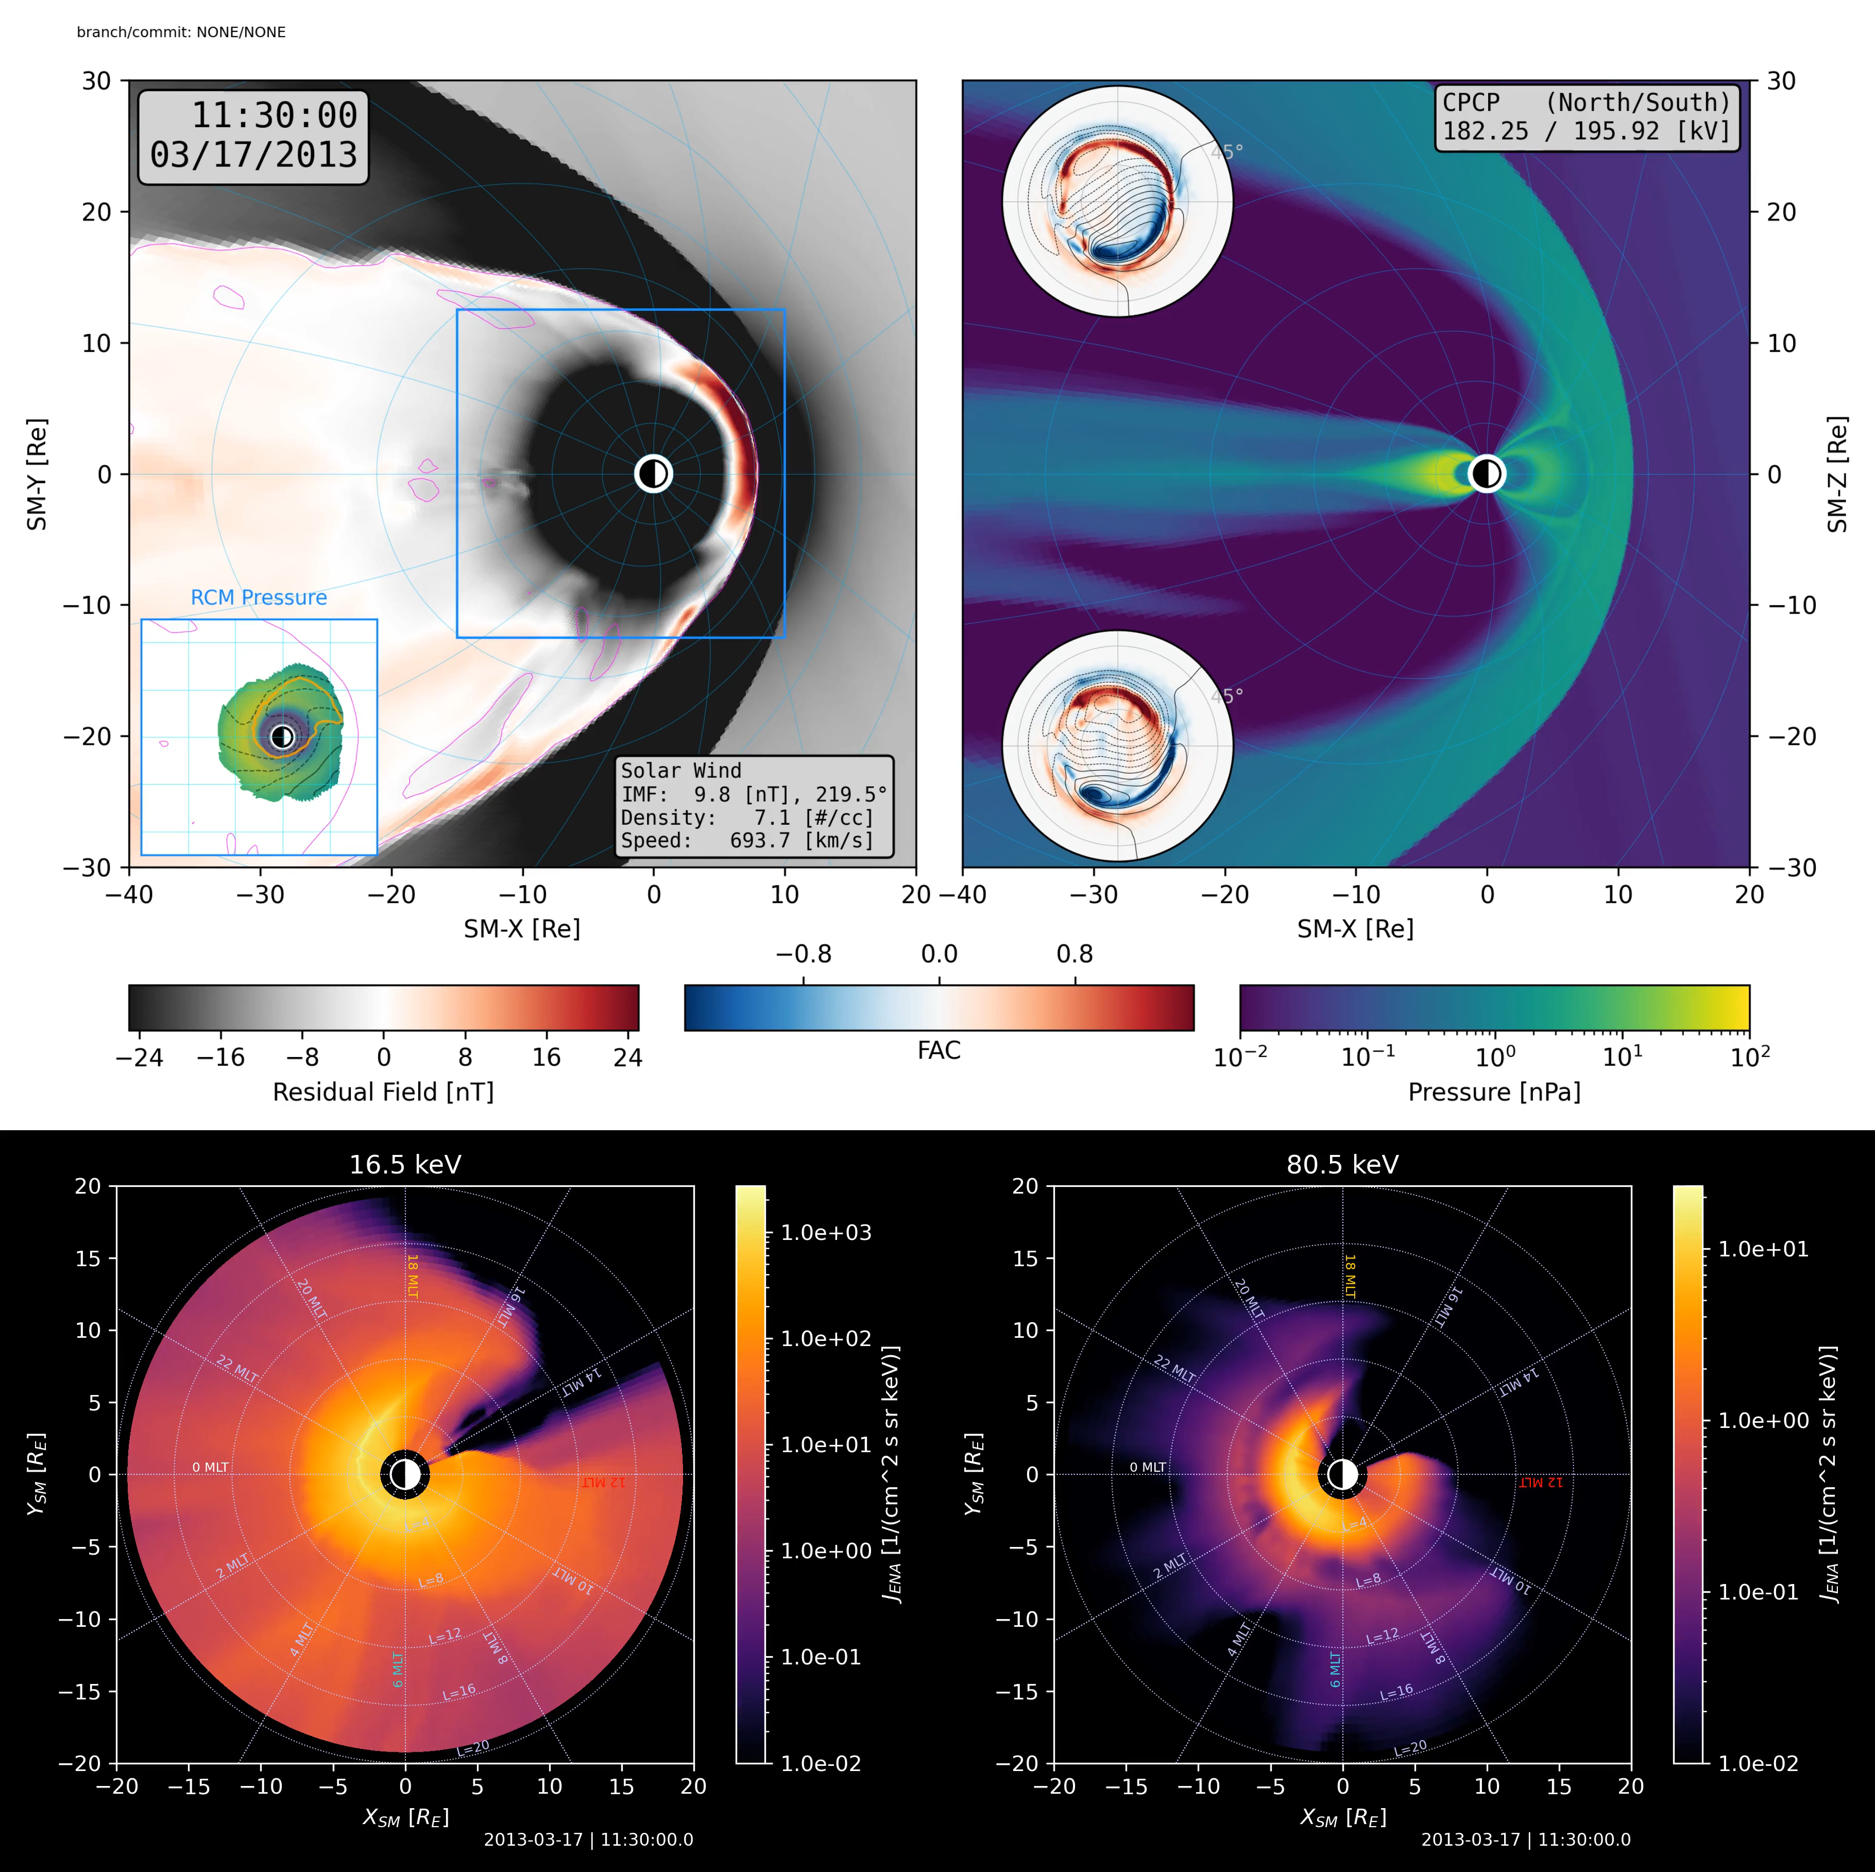
Modeling ENA Imaging with MAGE
Observing system simulation experiment (OSSE) for energetic neutral atom (ENA) imagers based on MAGE
Customizable to different imager characteristics and geometries (e.g., TWINS, IMAGE/MENA)
➔ Enables data-model comparisons with existing missions
Motivating question: By taking MAGE data as “ground truth,” what would an ENA imager be able to resolve in terms of mesoscale features?
➔ Can inform future mission design requirements
FOV
MAGE MHD input
= virtual satellite
Synthetic ENA flux output
Contact: Joel Tibbetts | joel.tibbetts@unh.edu Poster: SM13A-2772
Notes:
What this slide shows:
Top: MAGE model input from a simulation of the 2013 “St. Patrick’s Day” storm, showing signatures of a penetrating injection near 00:00 MLT, with increasing activity expanding dawnward as the simulation progresses.
Video spans a 15-minute window from 11:30-11:45 UT
Bottom: Synthetic ENA fluxes from the same interval, projected to the SM equatorial plane
Left: 16.5 keV ENA fluxes (“low-energy”)
Right: 80.5 keV ENA fluxes (“high-energy”)
This comparison demonstrates how mesoscale magnetotail features might appear in different energy channels of an ENA imager.
Low energy: Injection looks like a “depletion” in ENA flux near injection location.
High energy: Injection looks like an “enhancement” in ENA flux near injection location.
Main takeaway: This video shows features in synthetic ENA fluxes which map closely to mesoscale structures seen in MAGE.
Takeaways:
Global simulations like MAGE allow us to simulate ENA imaging.
This in turn can help inform future mission design requirements for using ENA imaging to study transient mesoscale magnetotail phenomena, like BBFs and injections.
Through these simulations, we may also gain insights for resolving ambiguities inherent to line-of-sight-integrated ENA imaging.
Possible FAQ topics + misc. details
ENA images on this slide were made using an “ideal” imager → Perfect instrument efficiencies, fixed vantage point, high angular resolution.
Imager angular resolution used here: ~1°x1°

